Slide 1
Event Management Solution
Devanshu Vasishth [cb.en.u4cse21218]
Sasidhar maddali [CB.EN.U4CSE21256]

Slide 2
Why Hybrid data structures ?
Hybrid data structures combine the strengths of different data structures to solve complex problems more efficiently. They leverage the unique characteristics and operations of each data structure to optimize performance, memory usage, or both.
The significance of hybrid data structures lies in their ability to address the limitations of individual data structures when dealing with specific problem domains. By combining different data structures, they can provide better time and space complexity for certain operations, leading to more efficient algorithms and improved overall performance.

Slide 3
OBJECTIVE
The objective of the project is to develop an Event Management System using a combination of different data structures to efficiently store and manipulate event data. The project utilizes a hybrid data structure comprising of a hash-map and list to store events, allowing fast access based on event names. The system supports operations like adding and removing events, adding and removing attendees, viewing event details, and maintaining a waiting list for events with conflicting dates.

Slide 4
IMPLEMENTATION
The chosen hybrid data structure in the provided project is a combination of an unordered map (hash map) and a list. The unordered map is used to store and retrieve events efficiently based on their names. The list is employed to maintain a list of attendees for each event

Slide 5
Advantages and Motivation
Using a hybrid data structure that combines an unordered map and a list offers several advantages:
Efficient Access and Retrieval: The unordered map provides fast access and retrieval of events based on their names, thanks to its hashing and indexing mechanisms. This ensures efficient searching and lookup operations.
Memory Efficiency: The list is utilized to store the attendees' names, which allows for flexible and efficient memory allocation. Unlike an array-based structure, the list doesn't require contiguous memory, enabling efficient memory management for `variable-sized lists of attendees.
Flexibility and Scalability: The hybrid data structure can handle a varying number of events and attendees. The unordered map allows for quick addition, removal, and lookup of events, while the list allows for efficient management and manipulation of the attendees' list.
Simplified Implementation: Combining an unordered map and a list simplifies the implementation of various operations. For instance, adding and removing attendees becomes more straightforward and efficient by utilizing the list's insertion and deletion capabilities.

Slide 6
IMPLEMENTATION
UNORDERED MAP
LIST
The unordered_map container is used to store events, with the event name as the key and the corresponding Event object as the value.
Events can be efficiently added, removed, and accessed using their names, leveraging the fast lookup capabilities of the unordered map.
The events unordered map is declared as a global variable to ensure its availability across different functions.
Each Event object stored in the unordered map contains a list to store the list of attendees.
The list is implemented using the list container from the STL.
Attendees can be added or removed from the list associated with a specific event.
The list allows for efficient insertion and deletion of attendees, ensuring flexible management of attendees' lists

Slide 7
PRACTICAL APPLICATIONS
Ticketing Systems:
Ticketing systems, such as those for concerts, theaters, or sports events, can benefit from the hybrid data structure.
The unordered map can store information about different events and their corresponding ticket availability, allowing quick lookup and updating of ticket availability.
The list can be used to maintain a list of attendees who have purchased tickets, facilitating efficient ticket validation and attendee management.
Reservation Systems:
Hybrid data structures can be employed in reservation systems, such as hotel bookings or restaurant reservations.
The unordered map can store reservation details for different entities (e.g., hotel rooms, tables), enabling fast retrieval and modification of reservation information.
The list can be utilized to track the guests associated with each reservation, allowing efficient addition and removal of guests.
Project Management Tools:
Project management tools often require efficient tracking of tasks, deadlines, and team members.
The unordered map can store information about different tasks or projects, providing quick access and management of task details.
The list can be used to maintain a list of team members associated with each task, allowing efficient assignment and tracking of team members.
The combination of an unordered map and a list in the hybrid data structure enables efficient operations for these applications:

Slide 8
LIMITATIONS
Memory Overhead: The hybrid data structure might have a higher memory overhead compared to a single data structure. The combination of an unordered map and a list requires memory allocation for both structures, potentially consuming more memory.
Lack of Concurrency Support: The provided implementation of the hybrid data structure does not incorporate concurrency control mechanisms. In scenarios where multiple threads or processes access and modify the data structure simultaneously, concurrency-related issues like race conditions can arise. Introducing appropriate synchronization mechanisms or exploring thread-safe data structures can address this challenge
Optimizing Memory Usage: Although the list provides flexibility in managing variable-sized lists of attendees, it can lead to memory fragmentation. Exploring alternative data structures that offer efficient memory utilization, such as dynamic arrays or self-balancing binary trees, could be beneficial in certain scenarios.

Slide 9
COMPLEXITY ANALYSIS
Time complexity:
O(1) for adding/removing an attendee and undoing the last operation. O(1) average case and O(n) worst case for adding/removing an event. O(n) for viewing event details and viewing all events. O(m) for viewing the waiting list and removing an event with a waiting event on the same date.
Space Complexity:
The space complexity of the code is primarily determined by the storage of events in the events map. It requires O(n) space, where n is the number of events. The undoStack uses O(u) space, where u is the number of performed operations that can be undone. The waitingList queue requires O(m) space, where m is the number of events in the waiting list.

Slide 10
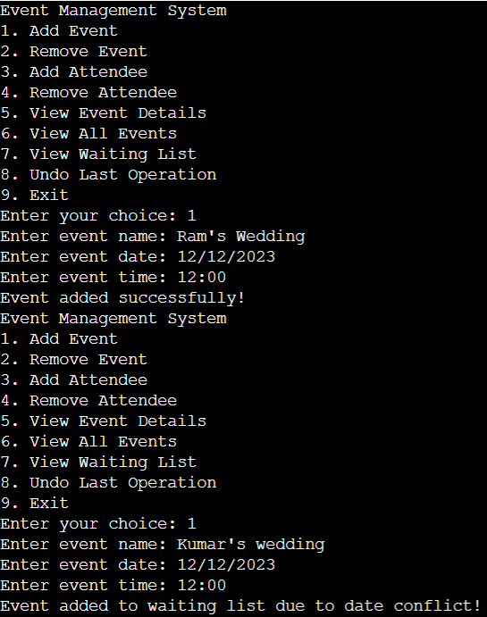
OUTPUT

Slide 11
CONCLUSION
In conclusion, the implemented hybrid data structure effectively manages events within the Event Management System. The combination of an unordered map, stack, and queue allows for efficient event handling, maintains a waiting list, and provides undo functionality. The system demonstrates practicality and usefulness in organizing events, tracking attendees, and displaying event details. While the implemented hybrid data structure showcases its effectiveness in managing events, there are certain limitations to consider. The performance may degrade when dealing with a large number of events or waiting list entries, and the system lacks certain advanced features for complex event management scenarios. Overall, the Event Management System provides a foundation for event organization and can be further enhanced and customized to meet specific requirements.

